Slide 1
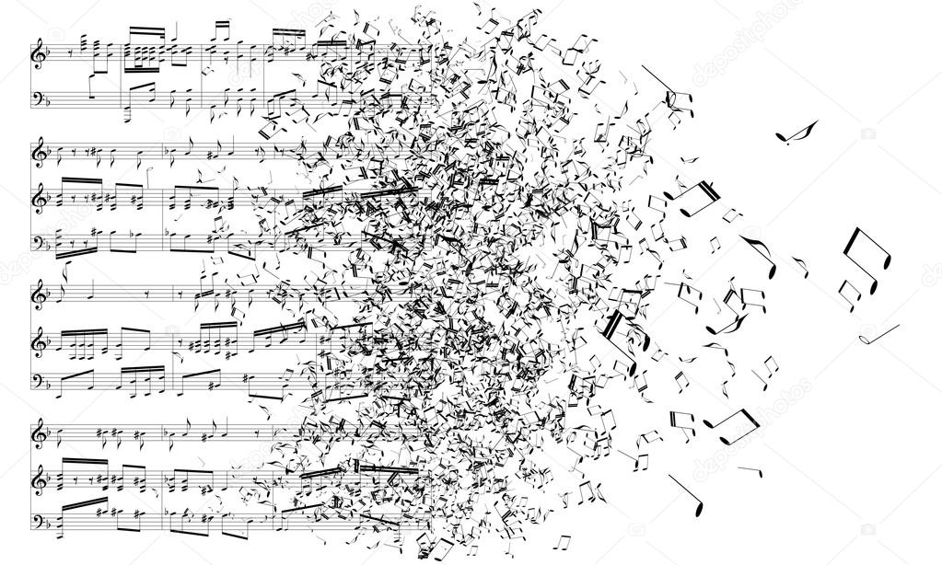
Latent possibilities of the tonal system the structure and historical usage of tonality
Vishnu Bachani
4 May 2018

Slide 2
Goals of the project
To distill the defining characteristics of tonality into a set of axioms in order to precisely and accurately delineate it.
To consider why tonality is enduring, pervasive, and robust as a musical language spanning several cultures, centuries, and genres.
To demonstrate how and why music works as a result of its structural underpinnings, using the tonal idiom (and its repertoire) as a case study.

Slide 3
Axioms of the tonal system
(not comprehensive)
Tonality…
divides the octave into twelve discrete pitches, creating a chromatic scale.
C
B
C#/Db
A#/Bb
D
continuous pitch space
discrete
pitch space
A
D#/Eb
G#/Ab
E
G
F
F#/Gb

Slide 4
Axioms of the tonal system
(not comprehensive)
Tonality…
chooses twenty-four diatonic scales from the chromatic scale for general use.
C
C
C
C
B
B
B
C#/Db
C#/Db
B
C#/Db
C#/Db
A#/Bb
A#/Bb
A#/Bb
A#/Bb
D
D
D
D
D#/Eb
D#/Eb
A
D#/Eb
A
A
D#/Eb
A
E
E
E
G#/Ab
E
G#/Ab
G#/Ab
G#/Ab
F
F
G
F
G
G
F
G
F#/Gb
F#/Gb
F#/Gb
F#/Gb

Slide 5
Axioms of the tonal system
(not comprehensive)
Tonality…
adheres to a set of syntactical rules governing the usage of notes and chords in any key.
Given Key X,
  Chord A → Chord B
  Chord B ↛ Chord A
  Chord C ↔ Chord D
  etc.

Slide 6
Propositions resulting from the axioms
(not comprehensive)
A key can by identified by elements which need not include the key note (also known as the tonic).
“Proof”: asymmetrical layout of the diatonic scales allows for orientability
C
C
B
C#/Db
B
C#/Db
A#/Bb
D
A#/Bb
D
A
D#/Eb
A
D#/Eb
G#/Ab
E
G#/Ab
E
G
F
G
F
F#/Gb
F#/Gb
Diatonic scale: C major scale
Non-diatonic scale: C whole tone scale

Slide 7
Propositions resulting from the axioms
(not comprehensive)
The function of a note or chord is determined by context (rather than by static definition).
“Proof”: asymmetrical scalar layout again, in addition to common syntactical progressions
C
C
function in C major – I (tonic)
B
C#/Db
sample progression:
I–V–I
C–G–C
A#/Bb
D
function in F major – V (dominant)
A
D#/Eb
V–I
C–F
sample progression:
G#/Ab
E
function in G major – IV (subdominant)
G
IV-V–I
C–D-G
G
F
F
sample progression:
F#/Gb
Example: C major chord

Slide 8
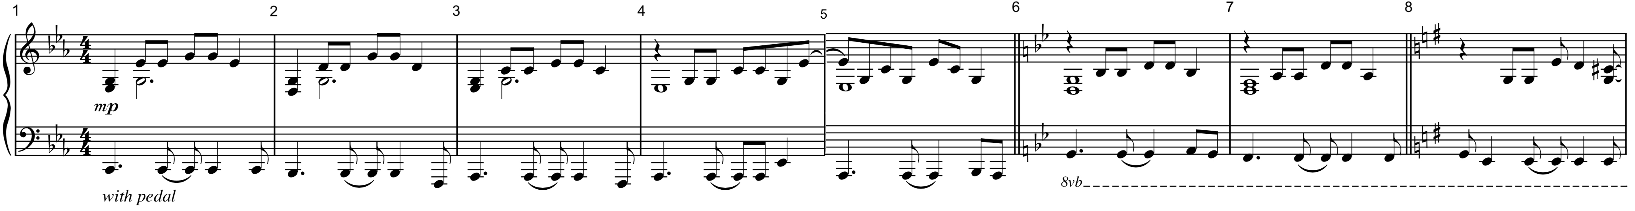
Case study – radiohead, “knives out”
(from the 2001 album amnesiac)
Measures: | 1 | 2 | 3-5 | 6 | 7 | 8
Chord: | C minor | G minor | Ab major | G minor | D minor | C# half-diminished seventh
Function (in C minor): | i | v | VI | v | ii | ???
opening phrase

Slide 9
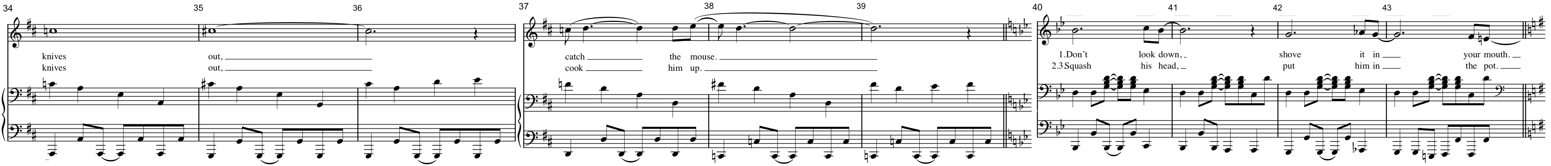
Case study – radiohead, “knives out”
(from the 2001 album amnesiac)
Measures: | 34 | 35-36 | 37 | 38-39 | 40-43 | 44
Chord: | A minor | A major | D minor | D major | G minor | C# half-diminished seventh
Function (in D minor): | v | V | i | V of G minor | i of G minor | ???
bridge section

Slide 10
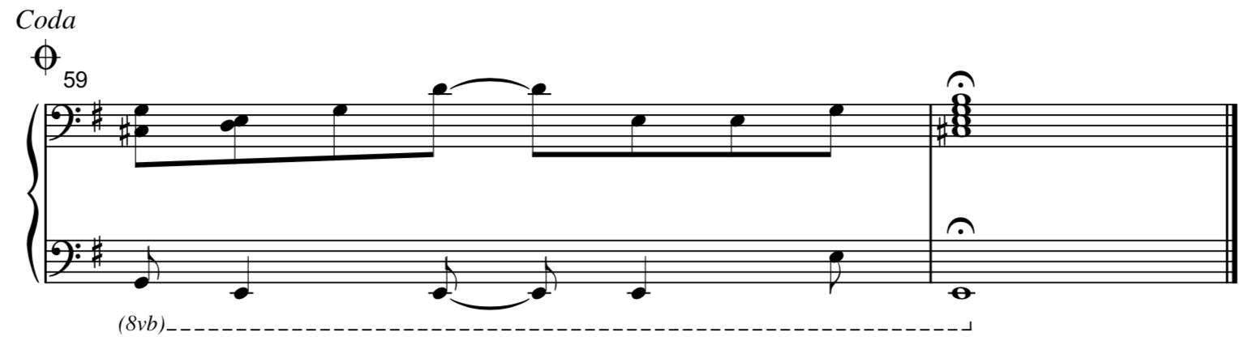
Case study – radiohead, “knives out”
(from the 2001 album amnesiac)
Measures: | 59-60
Chord: | C# half-diminished seventh
Function: | vii^{ø7} of D minor
coda

Slide 11
Further explorations
(from the full thesis)
Full exposition of five axioms of tonality
Six propositions with “proofs” and examples
Detailed musical analyses of:
  Richard Wagner, “Ein Schwert Verhieß mir der Vater” from Die Walküre (1870)
  Anton Bruckner, Symphony No. 4, coda (1880)
  Massive Attack, “Psyche” from Heligoland (2010)
Soon to be published on vishnubachani.com/music

